Slide 1
HOUSING PRICE PREDICTION PROJECT
Submitted by :
Chris Chhotai

Slide 2
TABLE OF CONTENTS
INTRODUCTION
BUSINESS PROBLEM FRAMING
CONCEPTUAL BACKGROUND OF THE DOMAIN PROBLEM
REVIEW OF LITERATURE
MOTIVATION FOR THE PROBLEM UNDERTAKEN
ANALYTICAL PROBLEM FRAMING
MATHEMATICAL/ ANALYTICAL MODELING OF THE PROBLEM
DATA SOURCES AND THEIR FORMATS
DATA PREPROCESSING DONE
DATA INPUTS- LOGIC- OUTPUT RELATIONSHIPS

Slide 3
MODEL/S DEVELOPMENT AND EVALUATION
IDENTIFICATION OF POSSIBLE PROBLEM-SOLVING APPROACHES (METHODS)
TESTING OF IDENTIFIED APPROACHES (ALGORITHMS)
RUN AND EVALUATE SELECTED MODELS
KEY METRICS FOR SUCCESS IN SOLVING PROBLEM UNDER CONSIDERATION
VISUALIZATIONS
INTERPRETATION OF THE RESULTS
CONCLUSION
KEY FINDINGS AND CONCLUSIONS OF THE STUDY
LEARNING OUTCOMES OF THE STUDY IN RESPECT OF DATA SCIENCE
LIMITATIONS OF THIS WORK AND SCOPE FOR FUTURE WORK

Slide 4
INTRODUCTION

Slide 5
BUSINESS PROBLEM FRAMING
Surprise Housing, a housing company located in the United States, has decided to enter the Australian market.
The company employs data analytics to buy houses for less than their true value and then resell them for more. The company has also gathered data from house sales in Australia for the same purpose.
We must use Machine Learning to create a model that will estimate the actual worth of potential properties and help us decide whether or not to invest in them.

Slide 6
CONCEPTUAL BACKGROUND OF THE DOMAIN PROBLEM
Property value frequently rises with time in real estate, as demonstrated in numerous countries. One of the reasons for this is that the population is growing.
The value of a property is also determined by its closeness, size, and location, as well as the target market for whom it is being sold.
For instance, if the audience is primarily interested in commercial purposes. Then, in comparison to the property located in a remote location, the property located in a heavily populated area will be sold quickly and at a high price. Similarly, if the audience is solely interested in a place to live, property in a less populated region with a vast area and all services will sell for a higher price.

Slide 7
REVIEW OF LITERATURE
Machine Learning is being used to forecast the actual worth of potential assets and decide whether or not to invest in them.

Slide 8
MOTIVATION FOR THE PROBLEM UNDERTAKEN
Houses are a basic need for everyone on the planet, so the housing and real estate sector is one of the most important contributors to the global economy.
It's a huge market with a lot of different companies operating in it.
Data science has emerged as a critical tool for firms to employ to solve challenges in the sector, such as increasing total income and profitability, enhancing marketing methods, and focusing on shifting trends in home sales and purchases.

Slide 9
MOTIVATION FOR THE PROBLEM UNDERTAKEN
Predictive modelling, Market mix modelling, recommendation systems are some of the machine learning techniques used for achieving the business goals for housing companies. Our problem is related to one such housing company.

Slide 10
ANALYTICAL PROBLEM
FRAMING

Slide 11
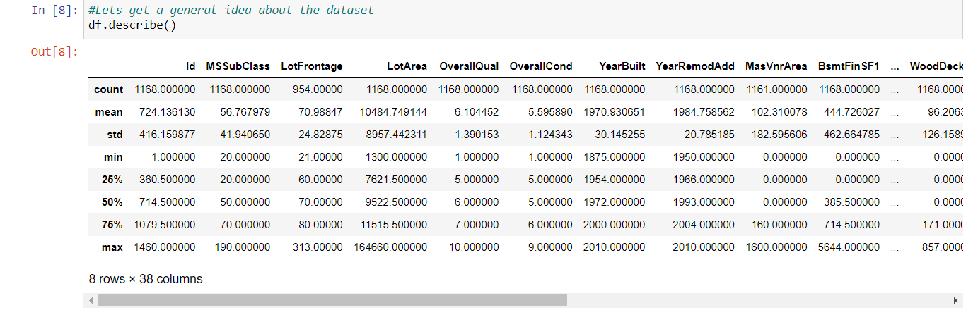
MATHEMATICAL/ ANALYTICAL MODELING OF THE PROBLEM
We examined the description or statistical summary of the data using describe, checked the correlation using corr, and visualised it using heatmap in this project. Then we plotted outliers and removed them using Z-Score..

Slide 12
MATHEMATICAL/ ANALYTICAL MODELING OF THE PROBLEM
We may deduce from this statistical analysis that the maximum standard deviation of 8957.44 is found in the LotArea column.
A house's maximum SalePrice seen is 755000, while its minimum is 34900.
In the columns:
Id, MSSubclass, LotArea, MasVnrArea, BsmtFinSF1, BsmtFinSF2, BsmtUnfsF, TotalBsmtSF, 1stFlrSF, 2ndFlrSF, LowQualFinSF, GrLivArea, BsmtFullBath, HalfBath, TotRmsAbvGrd, WoodDeckSF, OpenPorchSF, EnclosedPorch, 3SsnPorch, ScreenPorch, PoolArea, Miscval,

Slide 13
MATHEMATICAL/ ANALYTICAL MODELING OF THE PROBLEM
salePrice mean is considerably greater than median so the columns are positively skewed.
In the columns FullBath, BedroomAbvGr, Fireplaces, Garagecars, GarageArea, YrSold Median is greater than mean so the columns are negatively skewed.
In the columns Id, MSSubClass, LotFrontage, LotArea, MasVnrArea, BsmtFinSF1, BsmtFinSF2, BsmtUnfSF, TotalBsmtSF, 1stFlrSF, 2ndFlrSF, LowQualFinSF, GrLivArea, BsmtHalfBath, BedroomAbvGr, ToRmsAbvGrd, GarageArea, WoodDeckSF, OpenPorchSF, EnclosedPorch, 3SsnPorch,

Slide 14
MATHEMATICAL/ ANALYTICAL MODELING OF THE PROBLEM
ScreenPorch, PoolArea, MiscVal, SalePrice there is a significant discrepancy between the 75th percentile and the maximum, indicating that outliers exist.

Slide 15
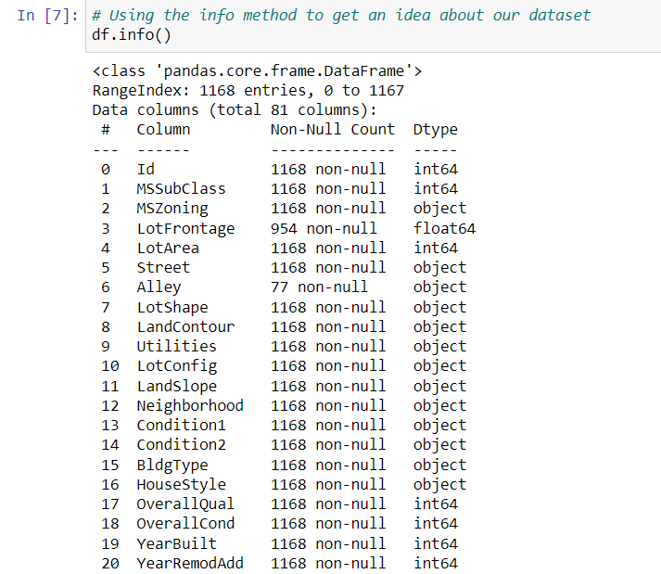
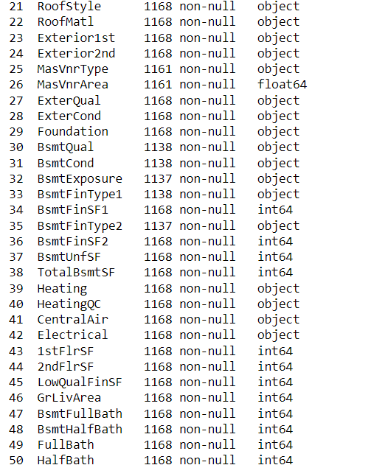
DATA SOURCES AND THEIR FORMATS

Slide 16
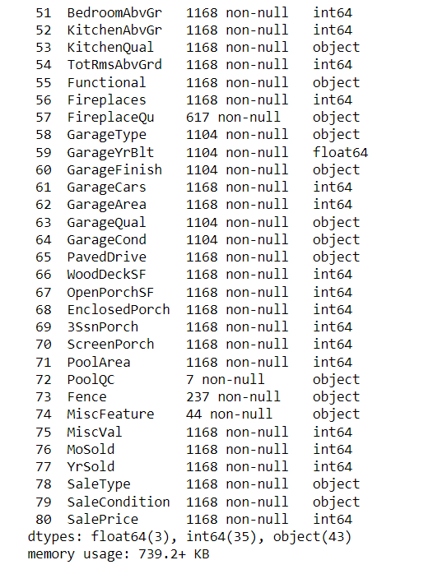
DATA SOURCES AND THEIR FORMATS

Slide 17
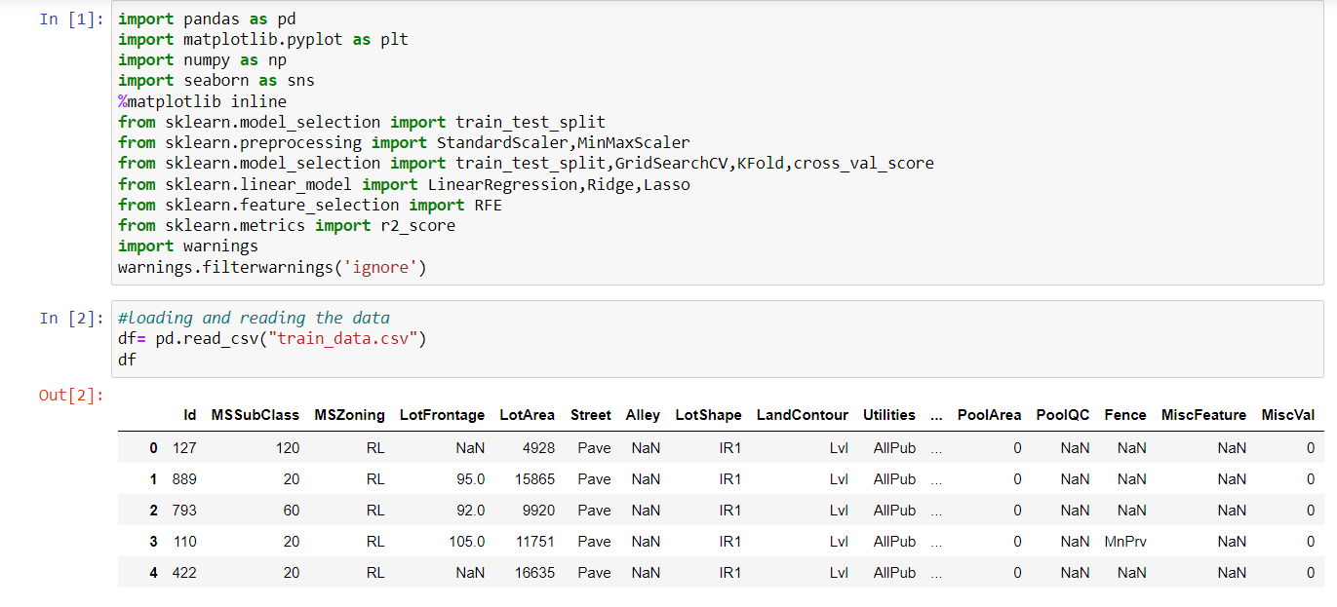
DATA PREPROCESSING DONE
After loading all the required libraries we loaded the data into our jupyter notebook.

Slide 18
DATA PREPROCESSING DONE
Feature Engineering has been used for cleaning of the data.
Some unused columns have been deleted and even some columns have been bifurcated which was used in the prediction.
We first done data cleaning. We first looked percentage of values missing in columns then we imputed missing values.

Slide 19
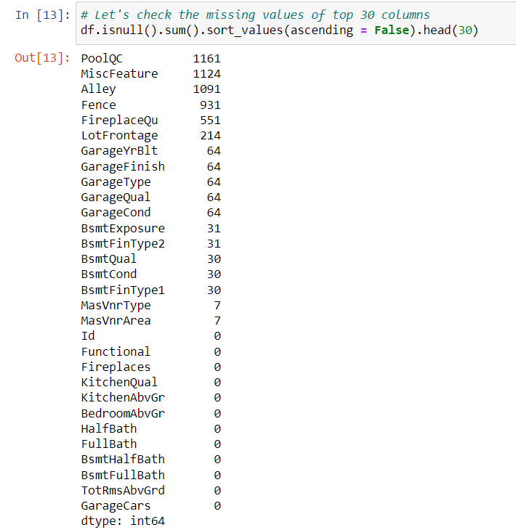
DATA PREPROCESSING DONE

Slide 20
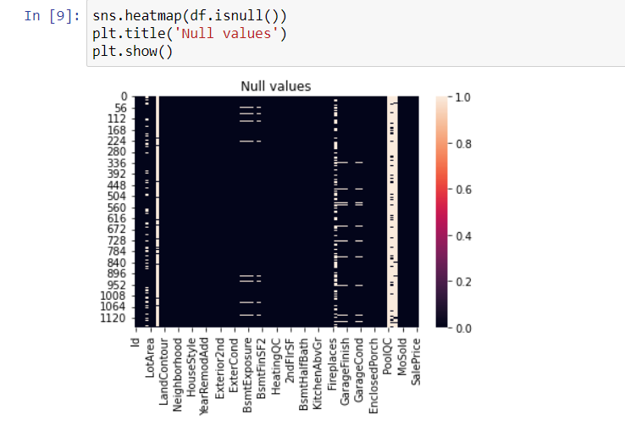
DATA PREPROCESSING DONE

Slide 21
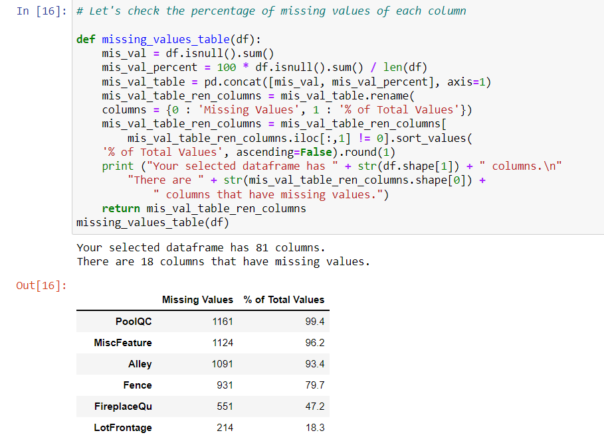
DATA PREPROCESSING DONE

Slide 22
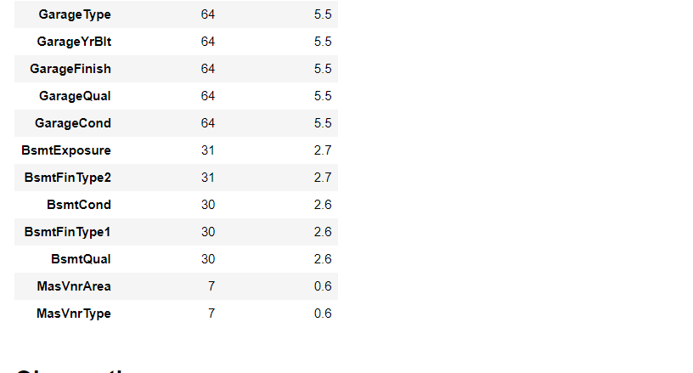
DATA PREPROCESSING DONE

Slide 23
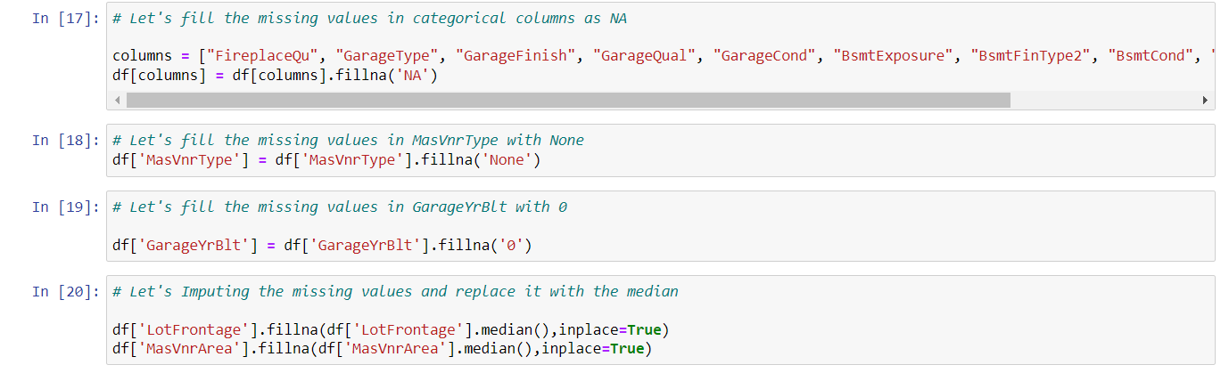
DATA PREPROCESSING DONE

Slide 24
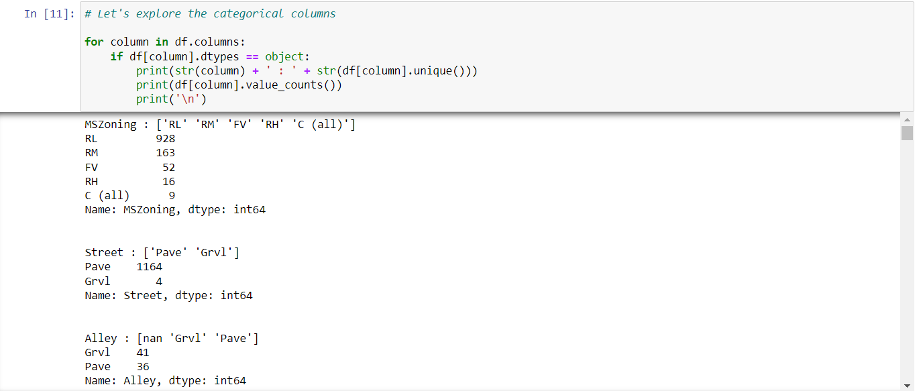
DATA PREPROCESSING DONE

Slide 25
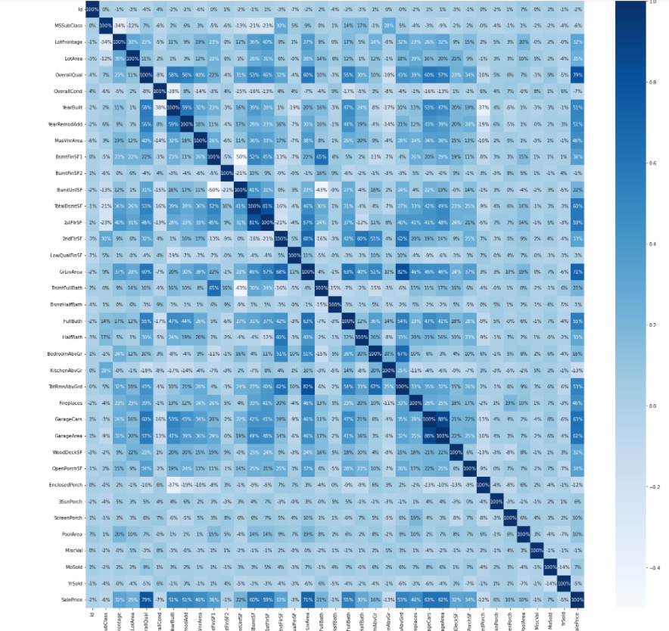
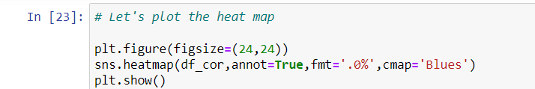
DATA PREPROCESSING DONE
Then, using a heatmap, we evaluated the correlation.

Slide 26
DATA PREPROCESSING DONE
While checking the heatmap of correlation we observed that:
SalePrice is a strong positive correlation between the columns OverallQual, YearBuilt, YearRemodAdd, TotalBsmtSF, 1stFlrSF, GrLivArea, FullBath, TotRmsAbvGrd, GarageCars, GarageArea.
SalePrice is negatively correlated with OverallCond, KitchenAbvGr, Encloseporch, YrSold.
Because we notice multicollinearity between columns, we'll use Principal Component Analysis (PCA)..
We will remove the column Id because there is no correlation between it and the other columns.

Slide 27
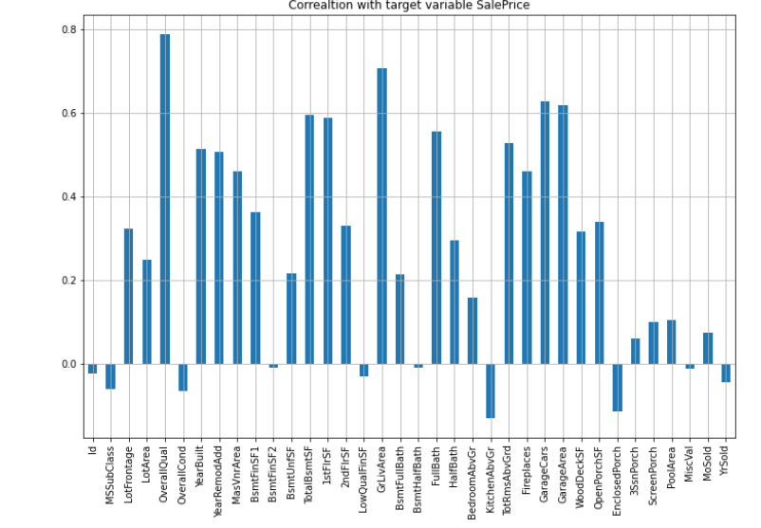
DATA INPUTS- LOGIC- OUTPUT RELATIONSHIPS

Slide 28
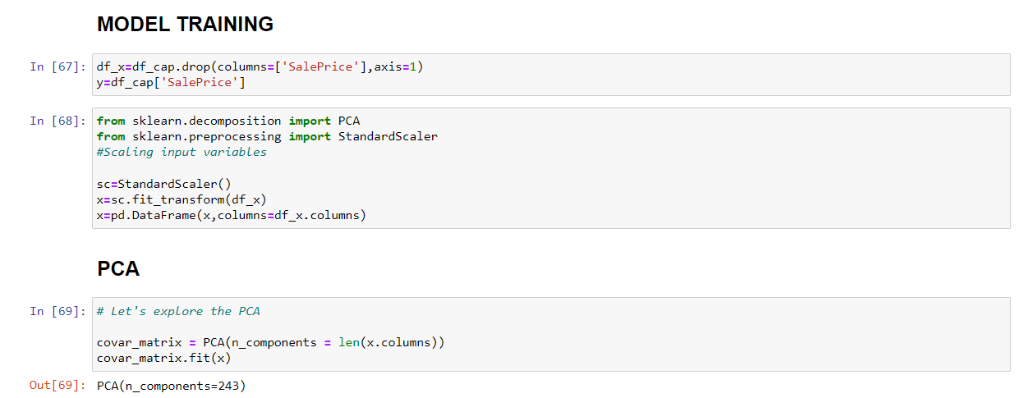
MODEL TRAINNING

Slide 29
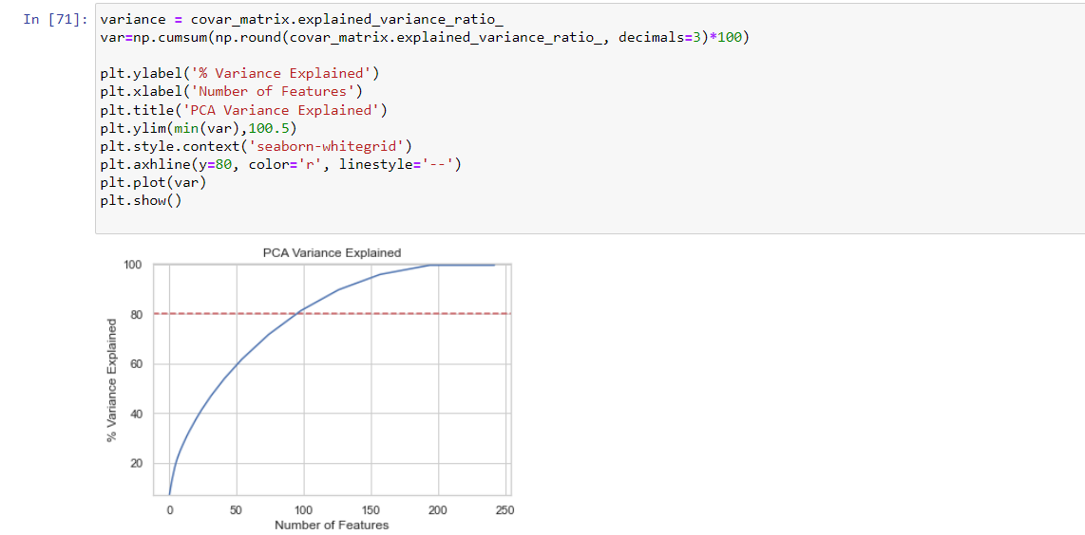
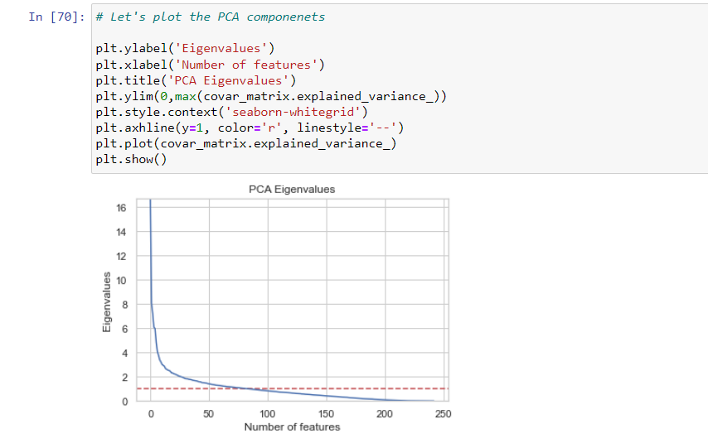
PCA

Slide 30
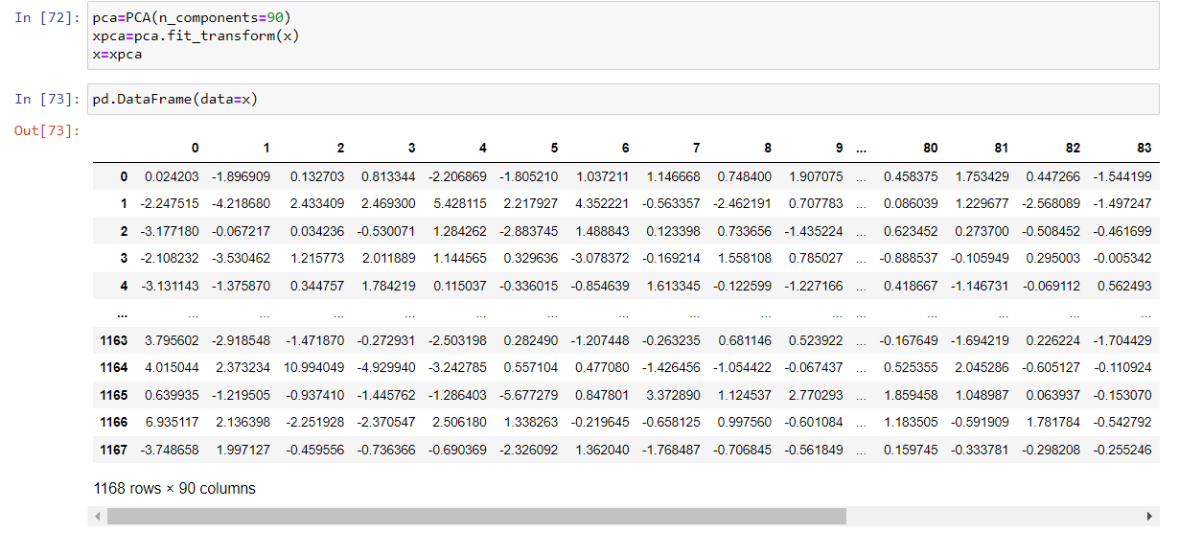
PCA

Slide 31
MODEL/S DEVELOPMENT
AND
EVALUATION

Slide 32
IDENTIFICATION OF POSSIBLE PROBLEM-SOLVING APPROACHES (METHODS)
We first converted all our categorical variables to numeric variables with the help of dummy variables to checkout and dropped the columns which we felt were unnecessary.
We observed skewness in data so we tried to remove the skewness through treating outliers with Winsorization technique.
The data was improper scaled so we scaled the feature variables on a single scale using sklearn’s StandardScaler package.

Slide 33
IDENTIFICATION OF POSSIBLE PROBLEM-SOLVING APPROACHES (METHODS)
We used Principal Component Analysis (PCA) to minimise the number of feature variables in the data from 256 to 100 by showing Eigenvalues and using the number of nodes as our number of feature variables.

Slide 34
TESTING OF IDENTIFIED APPROACHES (ALGORITHMS)
The algorithms we used for the training and testing are as follows:-
Linear Regression
Lasso
Ridge
Elastic Net
SVR
KNeighbors Regressor
Decision Tree Regressor
Random Forest Regressor
Ada Boost Regressor
Gradient Boosting Regressor

Slide 35
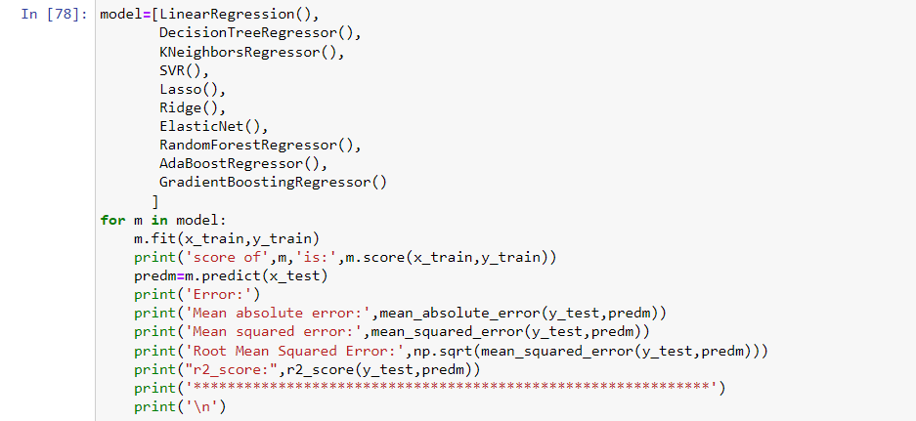
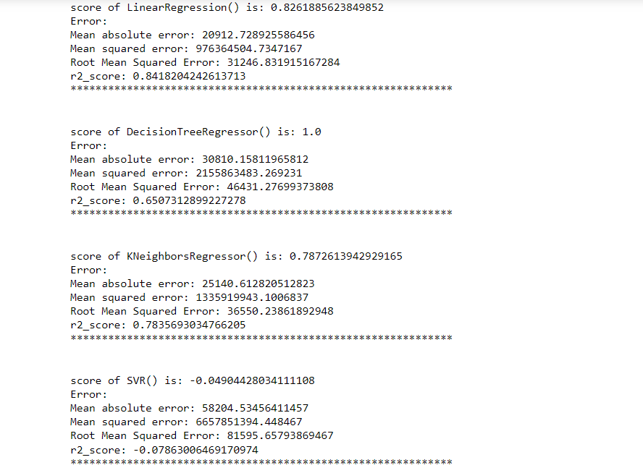
RUN AND EVALUATE SELECTED MODELS

Slide 36
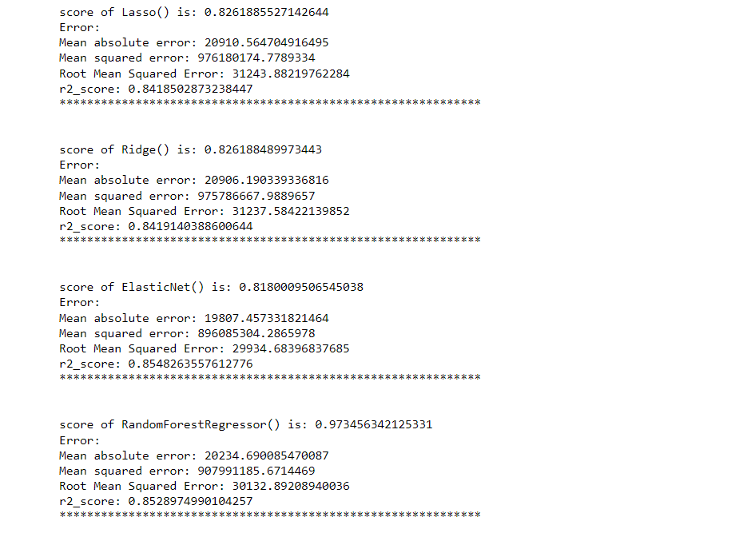
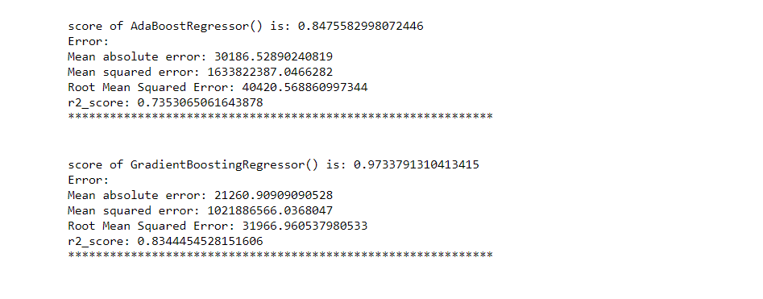
RUN AND EVALUATE SELECTED MODELS

Slide 37
KEY METRICS FOR SUCCESS IN SOLVING PROBLEM UNDER CONSIDERATION
We used the metric Root Mean Squared Error by selecting the Ridge Regressor model which was giving us best(minimum) RMSE score.

Slide 38
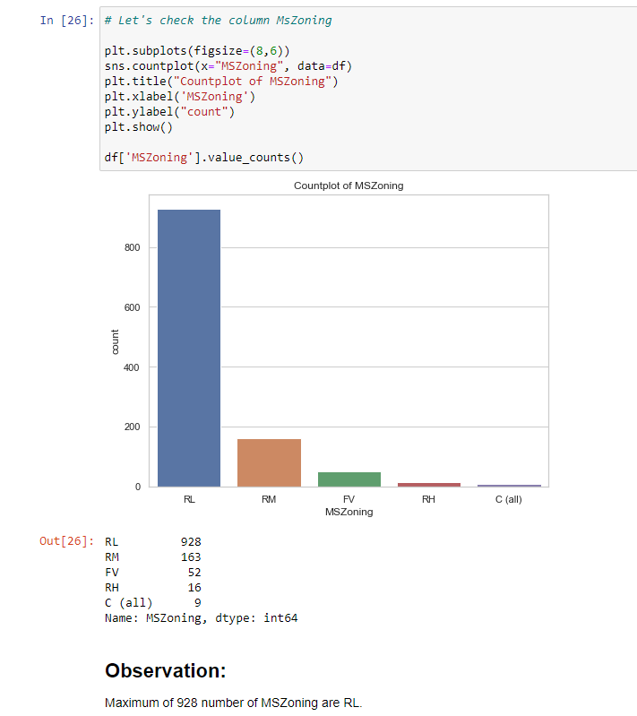
VISUALIZATIONS

Slide 39
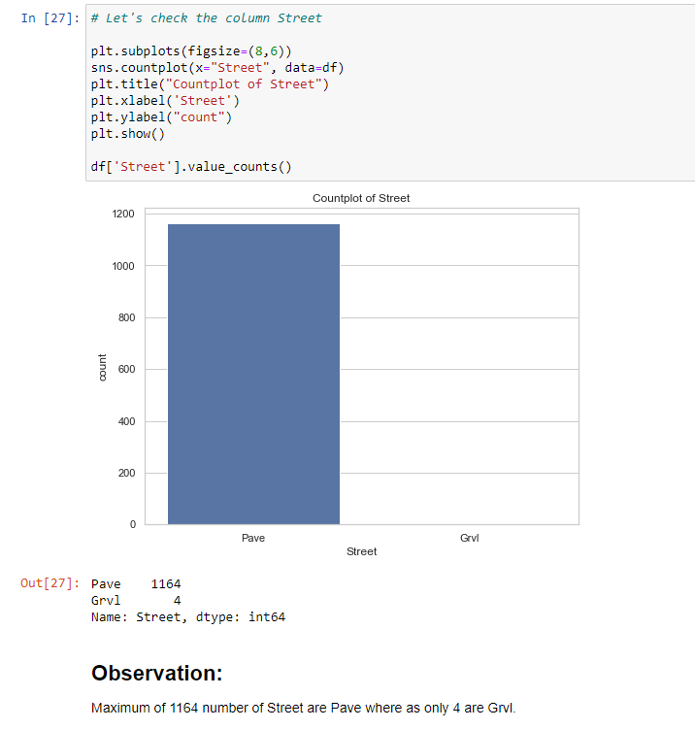
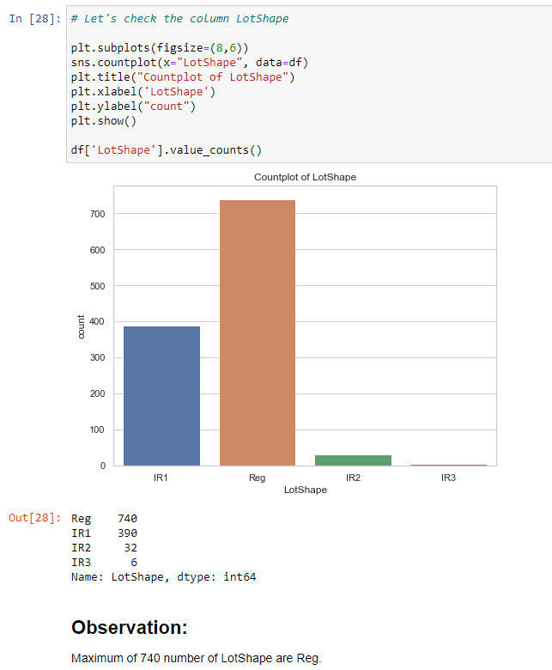
VISUALIZATIONS

Slide 40
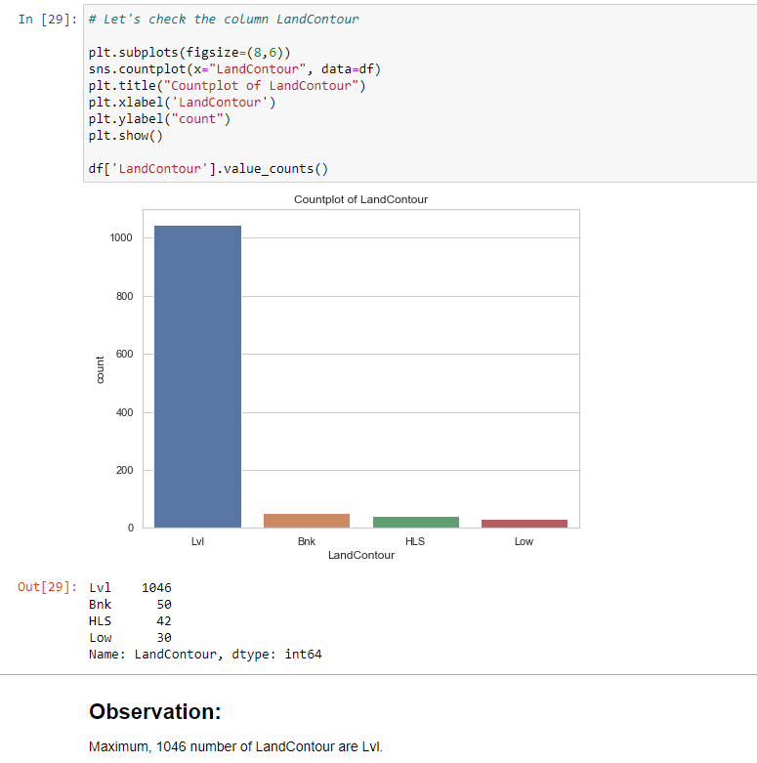
VISUALIZATIONS

Slide 41
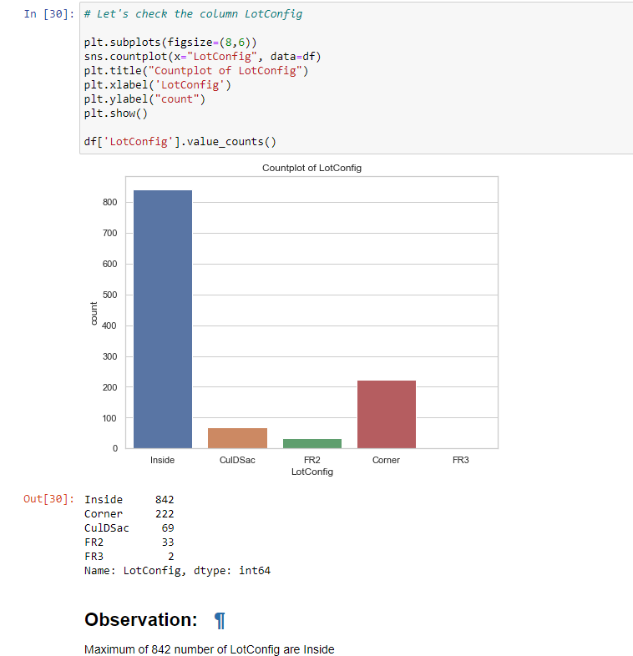
VISUALIZATIONS

Slide 42
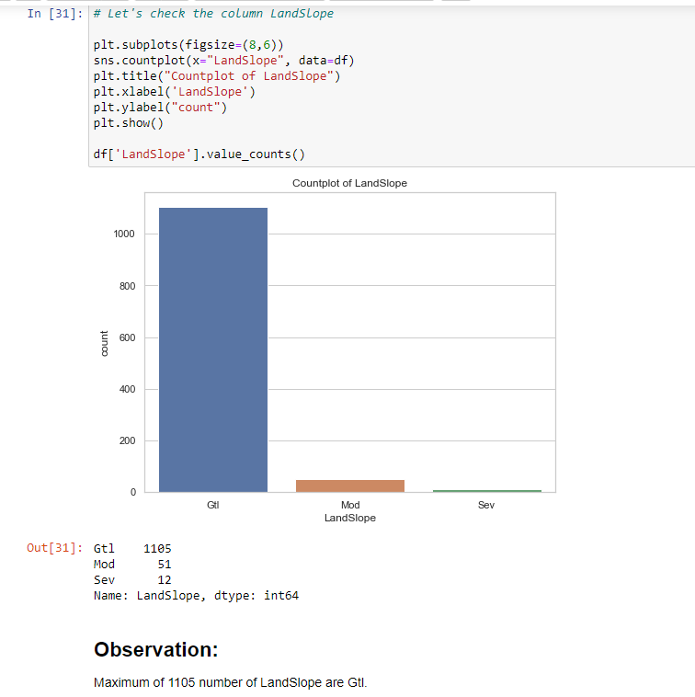
VISUALIZATIONS

Slide 43
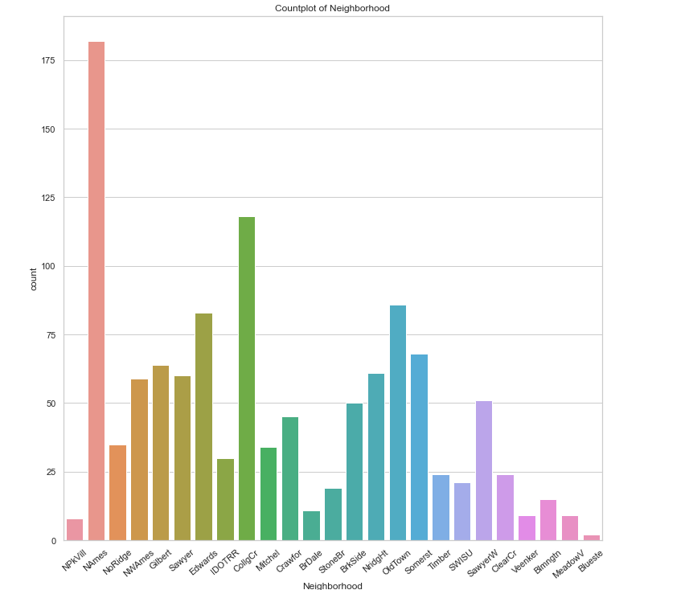
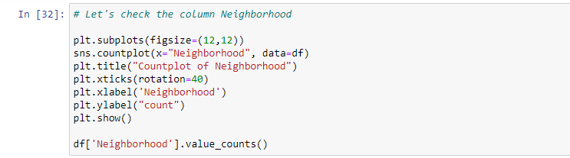
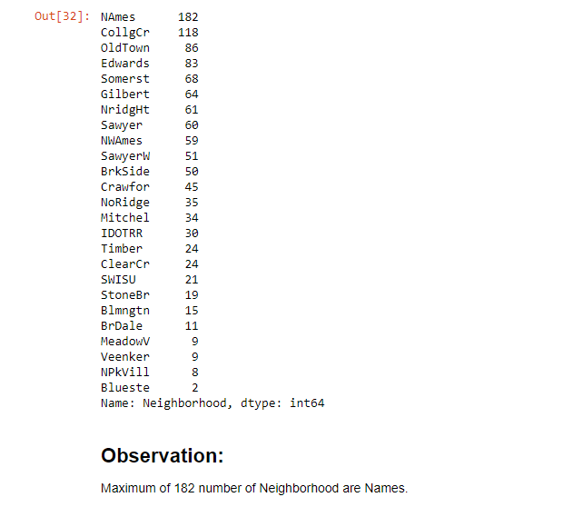
VISUALIZATIONS

Slide 44
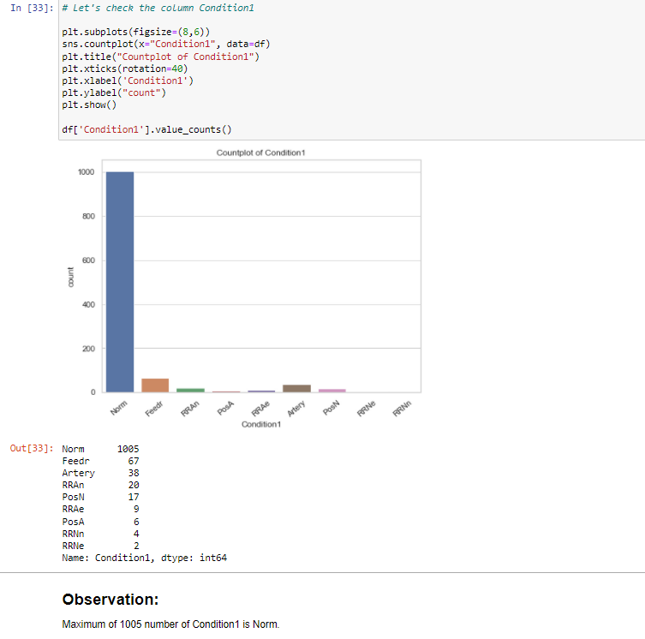
VISUALIZATIONS

Slide 45
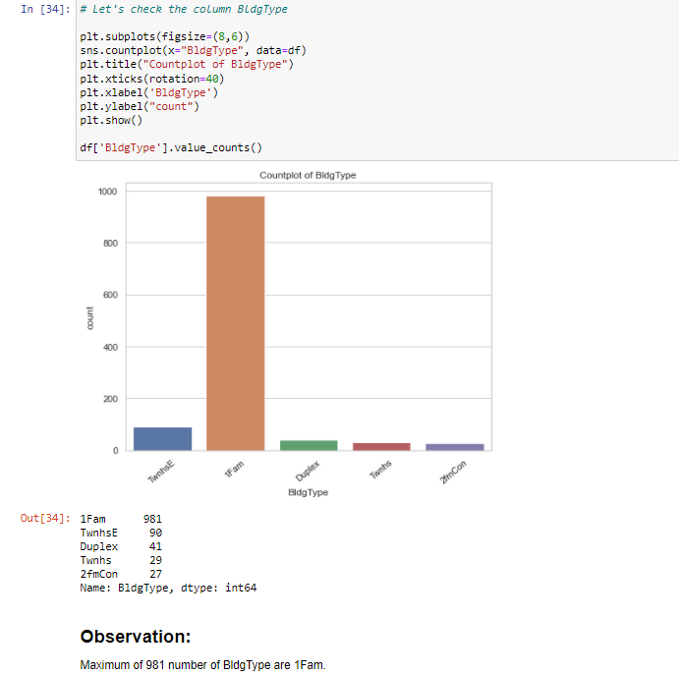
VISUALIZATIONS

Slide 46
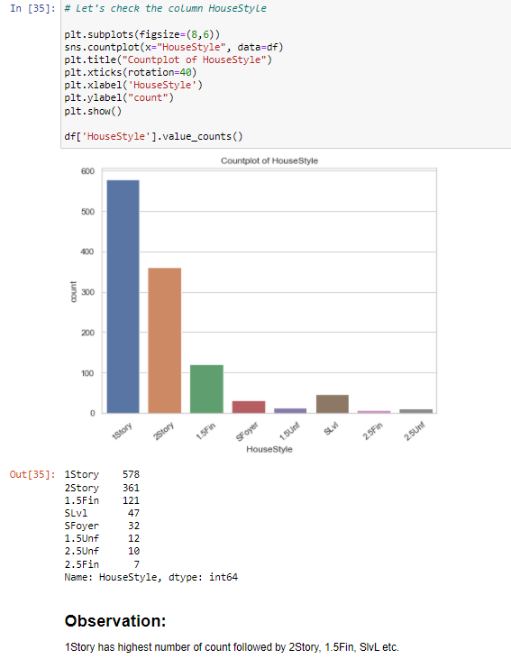
VISUALIZATIONS

Slide 47
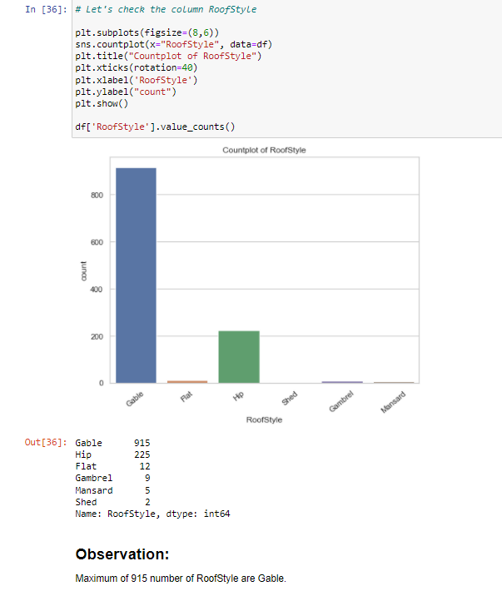
VISUALIZATIONS

Slide 48
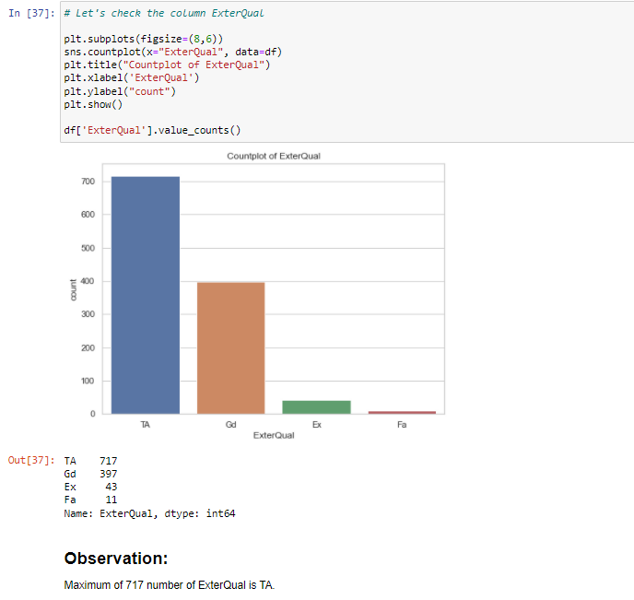
VISUALIZATIONS

Slide 49
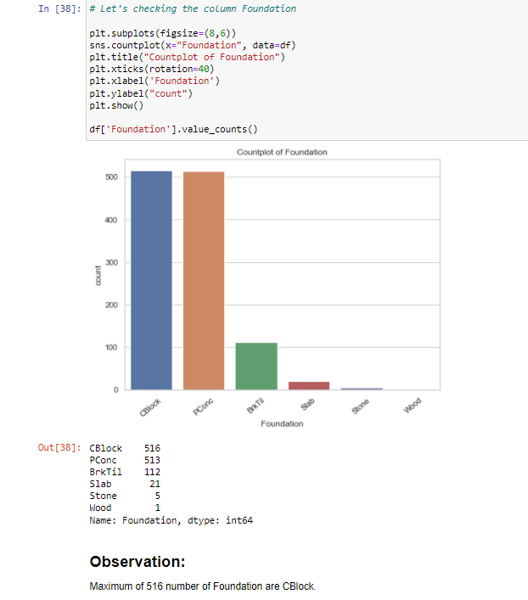
VISUALIZATIONS

Slide 50
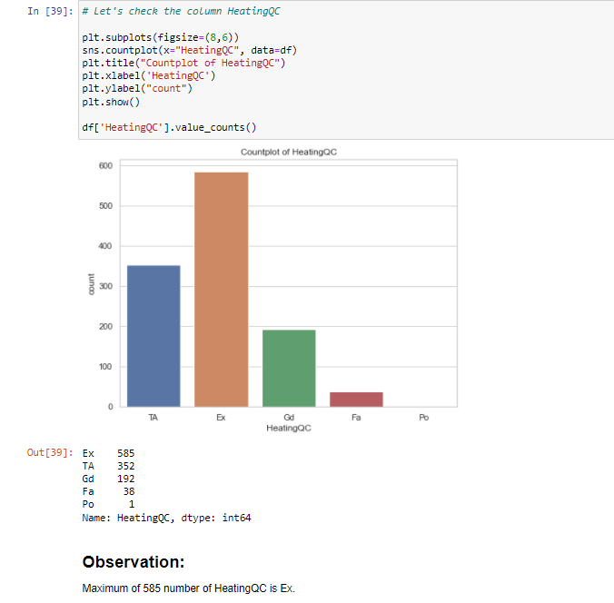
VISUALIZATIONS

Slide 51
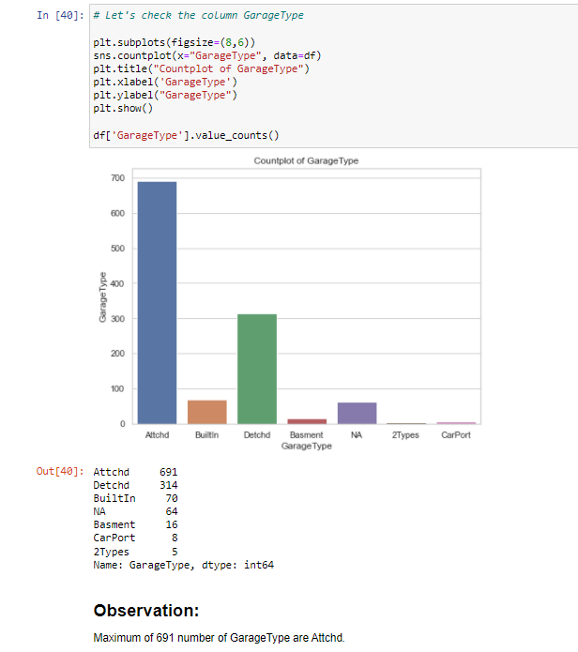
VISUALIZATIONS

Slide 52
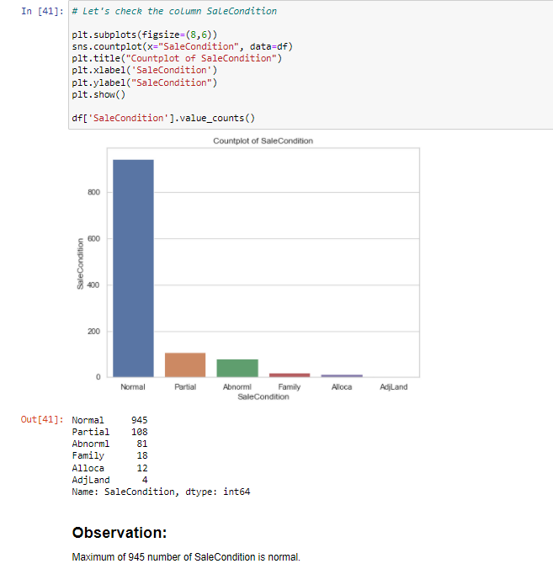
VISUALIZATIONS

Slide 53
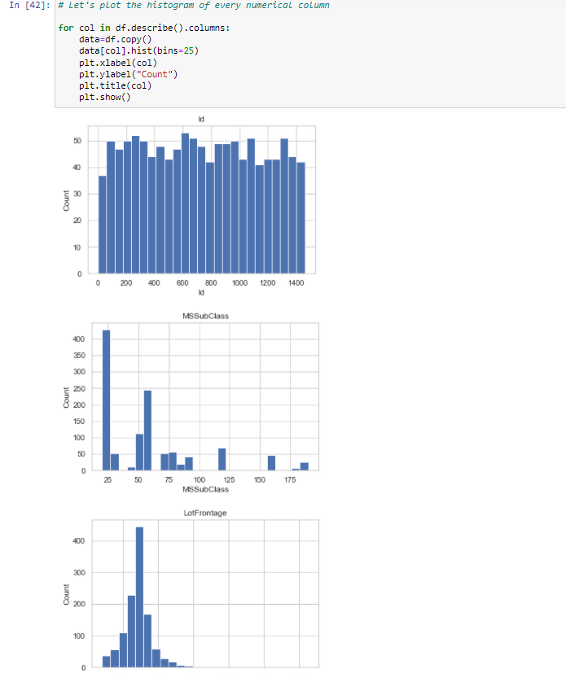
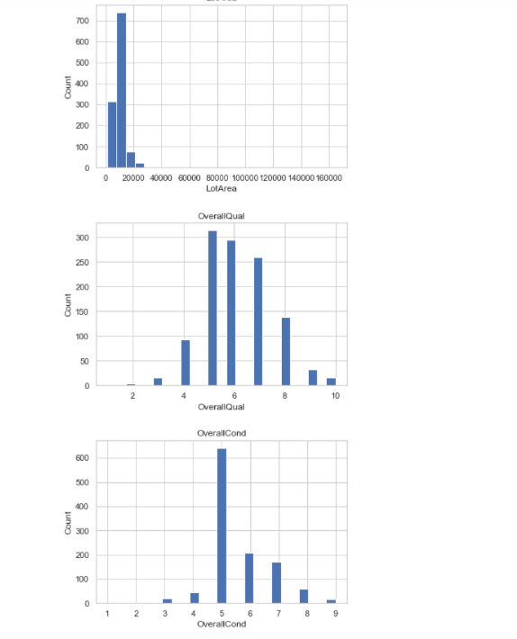
VISUALIZATIONS

Slide 54
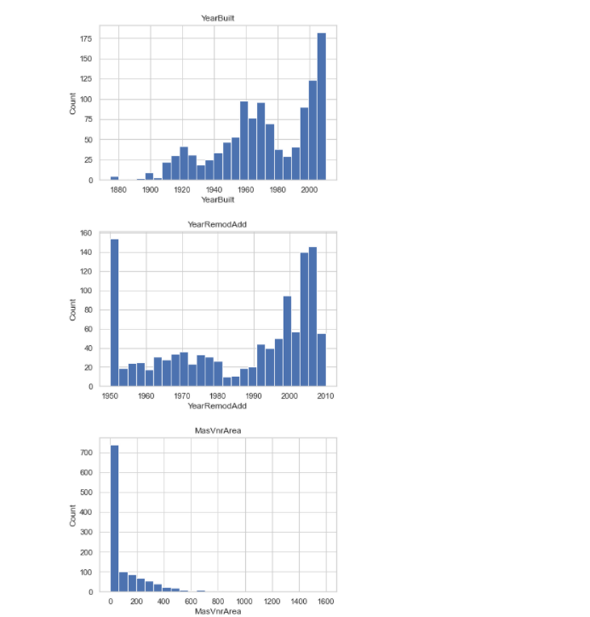
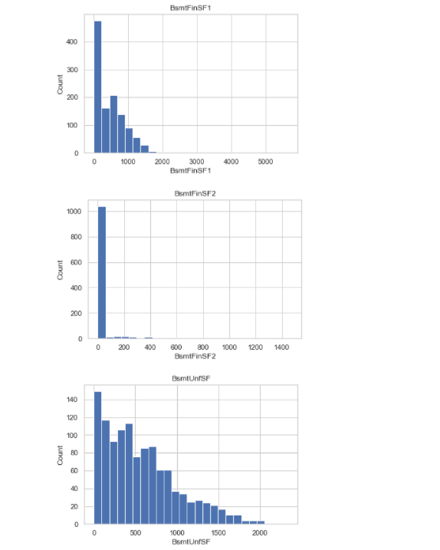
VISUALIZATIONS

Slide 55
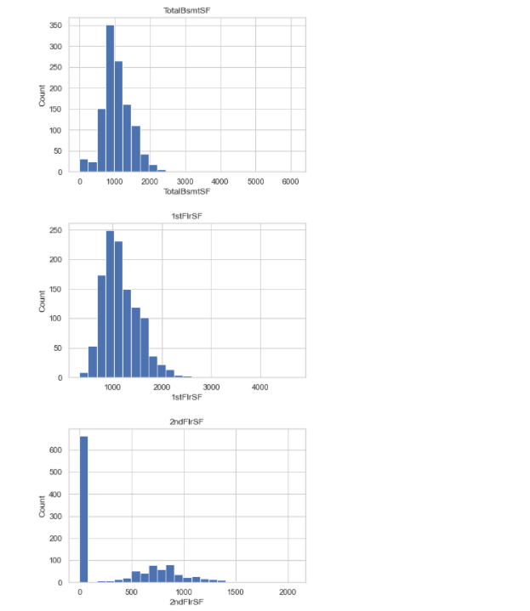
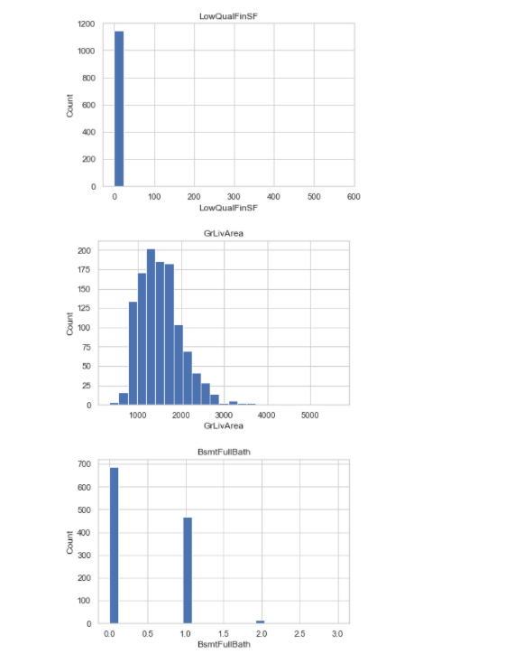
VISUALIZATIONS

Slide 56
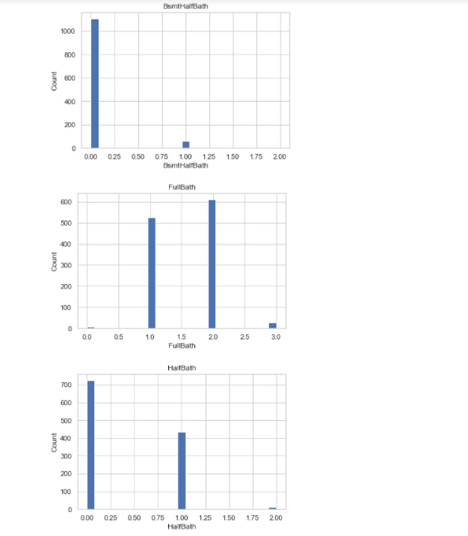
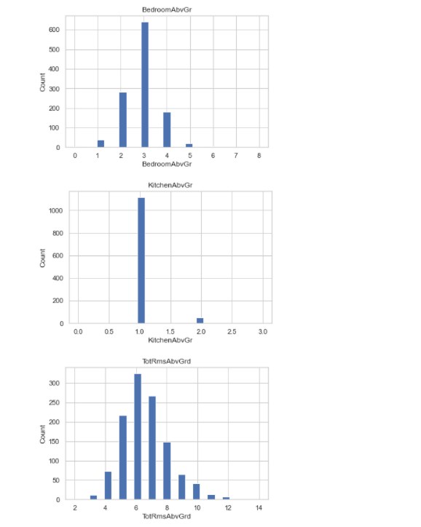
VISUALIZATIONS

Slide 57
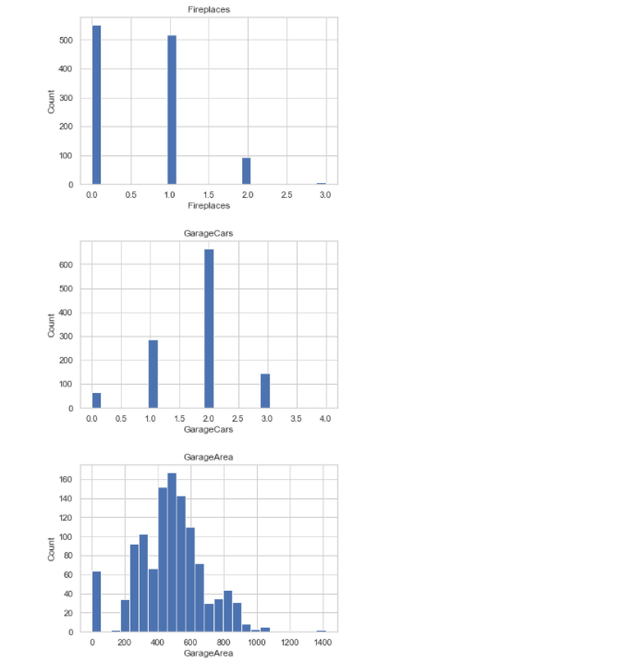
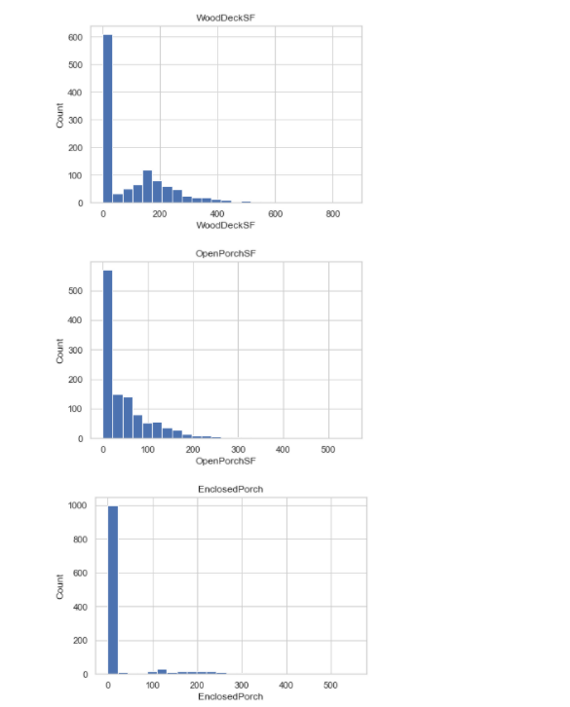
VISUALIZATIONS

Slide 58


VISUALIZATIONS

Slide 59

VISUALIZATIONS

Slide 60


VISUALIZATIONS

Slide 61


VISUALIZATIONS

Slide 62


VISUALIZATIONS

Slide 63


VISUALIZATIONS

Slide 64

VISUALIZATIONS

Slide 65

VISUALIZATIONS

Slide 66

VISUALIZATIONS

Slide 67

VISUALIZATIONS

Slide 68

VISUALIZATIONS

Slide 69

VISUALIZATIONS

Slide 70

VISUALIZATIONS

Slide 71

VISUALIZATIONS

Slide 72

VISUALIZATIONS

Slide 73


VISUALIZATIONS

Slide 74


VISUALIZATIONS

Slide 75

VISUALIZATIONS

Slide 76

VISUALIZATIONS

Slide 77
SET OF ASSUMPTIONS RELATED TO THE PROBLEM UNDER CONSIDERATION
We assumed it was a Regression problem after looking at the target variable label.
Because of the multicollinearity between columns, we decided to use Principal Component Analysis (PCA).
We also saw that the Utilities column had only one unique value, thus we anticipated that this column will be removed.

Slide 78
INTERPRETATION OF THE RESULTS
From the visualization we interpreted that the target variable SalePrice was highly positively correlated with the columns GrLivArea, YearBuilt, OverallQual, GarageCars, GarageArea.
We deduced from the preprocessing that the data had been scaled incorrectly.

Slide 79

INTERPRETATION OF THE RESULTS
From the modeling we interpreted that after hyperparameter tuning Ridge Regressor works best with respect to our model with minimum RMSE of 32302

Slide 80
CONCLUSION

Slide 81
KEY FINDINGS AND CONCLUSIONS OF THE STUDY
In this research, we attempted to demonstrate how housing prices fluctuate and the elements that influence their fluctuation. The best(minimum) RMSE score was achieved using the best parameters of Ridge Regressor through GridSearchCV though Lasso Regressor model performed well too.

Slide 82
LEARNING OUTCOMES OF THE STUDY IN RESPECT OF DATA SCIENCE
This experiment has highlighted the importance of effective sampling, modelling, and data prediction.
We were able to analyse and comprehend several hidden insights about the data using various advanced visualisation tools.
We were able to remove extraneous columns and outliers from our dataset using data cleaning, which would have caused our model to overfit or underfit.

Slide 83
LEARNING OUTCOMES OF THE STUDY IN RESPECT OF DATA SCIENCE
During the course of working on this project, there were a few obstacles to overcome which are:-
Improper scaling
Too many features
Missing values
Skewed data due to outliers
We used the sklearns package to scale the data to a single scale because it was improperly scaled.
Because there were too many (256) features in the data, we used Principal Component Analysis (PCA) to determine the Eigenvalues and were able to minimise our features to 90 columns based on the number of nodes.

Slide 84
LEARNING OUTCOMES OF THE STUDY IN RESPECT OF DATA SCIENCE
There were numerous missing values in various columns, which we interpolated based on our knowledge.
Due to the presence of outliers, the columns were skewed, which we corrected using the Winsorization Technique.

Slide 85
LIMITATIONS OF THIS WORK AND SCOPE FOR FUTURE WORK
While we were unable to achieve our aim of a minimum RMSE in house price prediction without allowing the model to overfit, we did create a system that can go very near to that goal given enough time and data.
There is always space for improvement in any endeavour. Because of the nature of this project, multiple algorithms can be merged as modules and their findings mixed to improve the accuracy of the final output.
More algorithms can be added to this model to improve it even further.

Slide 86
LIMITATIONS OF THIS WORK AND SCOPE FOR FUTURE WORK
These algorithms' output, however, must be in the same format as the others. The modules are simple to add once that criterion is met, as seen in the code.
The project gains a lot of modularity and versatility as a result of this.

Slide 87
CONCLUSION
In this research, we attempted to demonstrate how housing prices fluctuate and the elements that influence their fluctuation.
The best(minimum) RMSE score was achieved using the best parameters of Ridge Regressor through GridSearchCV though Lasso Regressor model performed well too.
While we were unable to achieve our aim of a minimum RMSE in house price prediction without allowing the model to overfit, we did create a system that can go very near to that goal given enough time and data.

